Slide 1
Detection of Autism Spectrum Disorder Final Team ID: P124 Panel No.: 17
S.No | Reg.No | Name of the Student | Branch & Section
1 | BL.EN.U4CSE20081 | Kotha Chakradhar | CSE-B
2 | BL.EN.U4CSE20082 | Kotte Thulasi Tharun | CSE-B
3 | BL.EN.U4CSE20124 | Periyavaram Sandesh Kumar Reddy | CSE-B
Project Guide: Dr Thangam S

Slide 2
Problem Definition
The detection of Autism Spectrum Disorder (ASD) poses a multifaceted challenge characterized by late diagnoses, the diverse and subjective nature of symptoms, limited access to specialized assessments, cultural and linguistic variability, and the absence of clear biomarkers. These issues contribute to delays in crucial interventions, hinder the establishment of standardized diagnostic criteria, and lead to disparities in diagnostic accuracy. Addressing these challenges necessitates a holistic and multidisciplinary approach, integrating technological advancements like artificial intelligence with a deep understanding of the behavioral, social, and cultural dimensions of ASD to develop accessible, objective, and universally applicable tools for early detection.

Slide 3
Literature Survey
S.No. | Authors name(s) | Full title of the paper with year | Inference from the paper | Open Problem (For proposed work)
1 | Y. Du, H. Hao, Y. Xing, J. Niu, V. D. Calhoun | "A Transdiagnostic Biotype Detection Method for Schizophrenia and Autism Spectrum Disorder Based on Graph Kernel," 2021 | Proposes a graph kernel-based clustering method for transdiagnostic biotype detection in ASD. | The open problem for the proposed work in this document is the need to effectively utilize brain functional connectivity (FC) to explore biotypes for ASD
2 | S. Ram Arumugam, S. Ganesh Karuppasamy, S. Gowr, O. Manoj, K. Kalaivani | "A Deep Convolutional Neural Network based Detection System for Autism Spectrum Disorder in Facial images," 2021 | Introduces a deep learning approach for ASD detection using facial images. The system aims to identify ASD at earlier stages | Potential for further development to identify the stages of Autism Spectrum Disorder

Slide 4
Literature Survey
S.No. | Authors name(s) | Full title of the paper with year | Inference from the paper | Open Problem (For proposed work)
3 | S. Bose, P. Seth | "Screening of Autism Spectrum Disorder using Machine Learning Approach in Accordance with DSM-5," 2023 | Utilizes machine learning for ASD screening aligned with DSM-5 criteria. | Enhancing the model's specificity and sensitivity and exploring real-time applications for screening in diverse settings.
4 | T. L. Praveena, N. V. M. Lakshmi | "Multi Label Classification for Emotion Analysis of Autism Spectrum Disorder Children using Deep Neural Networks," 2021 | Proposes a deep neural network for emotion analysis in ASD children. Uses Face Landmarks to predict. | Enhancing the model to extract more nuanced features could lead to better predictions

Slide 5
Literature Survey
S.No. | Authors name(s) | Full title of the paper with year | Inference from the paper | Open Problem (For proposed work)
5 | M. S. Venkata Sai Krishna Narala, S. Vemuri, C. Kattula | "Prediction of Autism Spectrum Disorder Using Efficient Net," 2023 | Utilizes Efficient Net for predicting ASD. | There is potential to further develop the model
6 | Varsha P, Uma Maheswari V | "Identification of Autism Spectrum Disorder in Children from Facial Features Using Deep Learning," 2023 | Densenet121, and InceptionV3, effectively extracted facial features to differentiate between children with ASD | Identifying Autism Spectrum Disorder from facial features using deep learning is improving model generalization and robustness across diverse populations and datasets.

Slide 6
Literature Survey
S.No. | Authors name(s) | Full title of the paper with year | Inference from the paper | Open Problem (For proposed work)
7 | Aryan Raghav, Aayush Anand RishabhS harma, Nirdesh Singh | "Autism Spectrum Disorder Detection in Children Using Transfer Learning Techniques.“ -2023 | It highlights the potential of machine learning models, particularly EfficientNetB5, in accurately classifying individuals with ASD, emphasizing the importance of high-quality datasets and model optimization for effective ASD detection. | For further research to validate findings, enhance model robustness, and incorporate multiple modalities for improved accuracy and generalizability in Autism Spectrum Disorder (ASD) detection..
8 | SajeevRam Arumugam, Balakrishna R Rashmita Khilar Oswalt Manoj Shylaja CS | "Prediction of Autism Spectrum Disorder in Children using Face Recognition," 2021 | The paper utilizes CNN for classifying facial images to detect Autism Spectrum Disorder (ASD) in children, achieving a high accuracy rate of 91% and emphasizing the importance of early detection and therapy for ASD. | An open problem in the field is the need for real-time datasets to further develop systems that can identify the stages of Autism Spectrum Disorder (ASD).

Slide 7
Literature Survey
S.No. | Authors name(s) | Full title of the paper with year | Inference from the paper | Open Problem (For proposed work)
9 | R. Mittal, V. Malik, A. Rana | "DL-ASD: A Deep Learning Approach for Autism Spectrum Disorder," 2022 | Introduces a deep learning approach (DL-ASD) for ASD. | Evaluating the model's performance across different age groups and exploring its potential in real-world clinical scenarios.
10 | Ritesh Chandra, Sadhana Tiwari, Ashutosh Kumar, Sonali Agarwal, | "Autism Spectrum Disorder Detection using Autistic Image Dataset," 2022 | The proposed modification of VGG16 and VGG19 models for detecting ASD from facial images outperformed the original models with an accuracy of 82.55% and 80%, respectively. | An open problem in the field of autism detection using facial images is the high computational cost and the challenge of addressing the vanishing gradient issue in the architecture.

Slide 8
Justification for the Proposed Problem
Improving the detection of Autism Spectrum Disorder (ASD) is essential due to the impact of early intervention on long-term outcomes. Late diagnoses result in missed intervention opportunities during crucial developmental periods. Heterogeneous symptoms and subjective diagnostics lead to delays and inconsistencies. Limited access to specialized assessments exacerbates disparities in diagnosis, especially in underserved areas. The absence of clear biomarkers highlights the need for more objective and universally applicable tools. Addressing these challenges aims to enhance accuracy, accessibility, and cultural sensitivity in ASD detection. This aligns with the goal of optimizing developmental outcomes and improving the quality of life for individuals with ASD and their families.

Slide 9
Software/Tools Requirements
Python: Primary programming language for implementing the solution.
TensorFlow & Keras: Deep learning frameworks to design, train, and test models.
OpenCV: For image processing tasks.
Google Colab: Cloud-based platform providing GPUs for training deep learning models.
Pandas & Matplotlib: Data manipulation and visualization.
Scikit-learn: Data splitting, shuffling, and potential additional machine learning tasks.
Google Drive: Data storage and retrieval for datasets and trained models.
Matplotlib: Matplotlib is an extensive Python data visualization toolkit that is essential. Researchers and healthcare practitioners may display medical data, diagnostic results, and model performance using its extensive toolkit for producing static, animated, and interactive charts.
TensorBoard: For monitoring training progress.
Pytorch: Provides a flexible framework for building and training deep learning models.
Streamlit: Python library that enables you to create web applications for data science and machine learning with just a few lines of code

Slide 10
Hardware/Tools Requirements
A modern multi-core processor (e.g., Intel i7 or i9, AMD Ryzen).
Graphics Processing Unit (GPU): A high-performance NVIDIA GPU (e.g., NVIDIA RTX 3070, 3080). GPUs accelerate the training process considerably.
Minimum of 8GB VRAM, but 11GB or higher is recommended for handling
RAM: At least 16GB of RAM is recommended to handle large datasets in memory and to facilitate multiple processes running concurrently during model training and hyperparameter tuning and while using Streamlit.

Slide 11
Dataset
Source of data set:
https://www.kaggle.com/datasets/cihan063/autism-image-data
The "Autism Image Data" dataset on Kaggle consists of images relevant to Autism Spectrum Disorder (ASD), including facial images, and behavioral observations. Each image is accompanied by labels indicating autism diagnosis status. This dataset serves to train machine learning models for autism detection, conduct research on visual traits associated with ASD, and explore correlations between data and autism characteristics. This dataset can be used for academic studies, algorithm development, educational projects, or exploratory analyses.

Slide 12
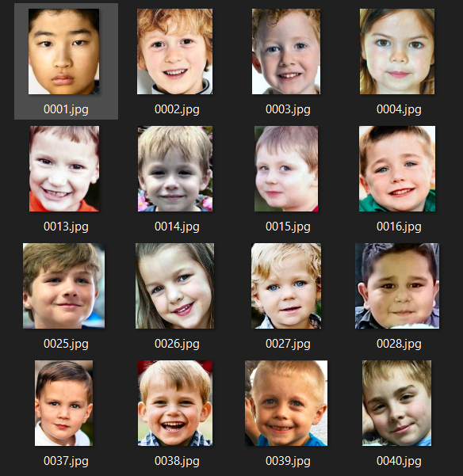
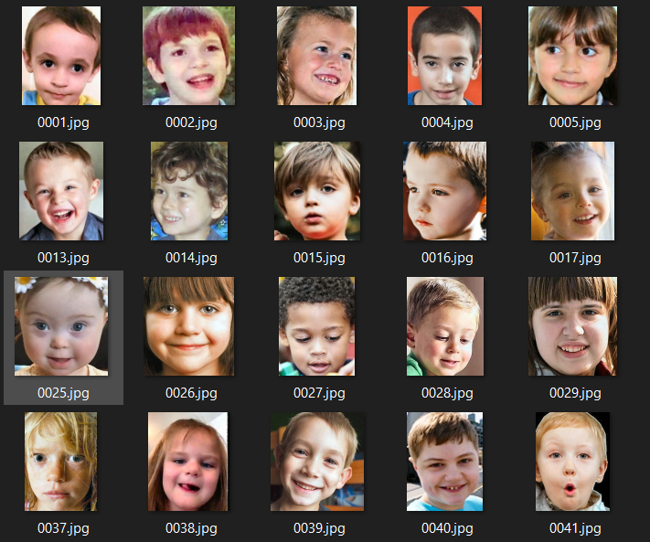
Dataset
Autistic
Non_Autistic

Slide 13
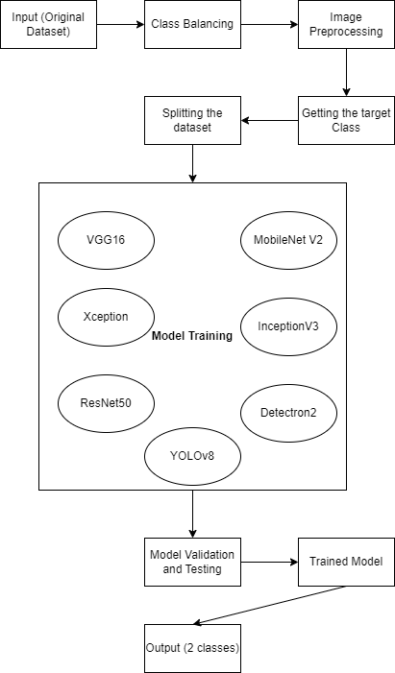
Methodology

Slide 14
Proposed Method
1. Dataset Preparation:
Collect a set of face images of age 2-7. Classify them into autistic and non autistic.
2. Data Augmentation:
Apply data augmentation techniques like rotation, flipping, and scaling to increase the diversity of the training dataset.
3. Model Architecture:
Experiment with various CNN architectures like Basic CNN, VGG16, ResNet50, and InceptionV3. Choose a suitable loss function (Binary cross entropy) for binary classification. As we got higher loss we experiment with Detectron and YOLOv8.
4. Model Training:
Split the dataset into training and validation sets. Train the models using the dataset.
5. Evaluation:
Evaluate the models on a separate test set to measure their performance. Metrics to be used are accuracy and loss function.

Slide 15
Architecture / Design ( User Interface)
The proposed system follows a simple client-server architecture.
The backend is implemented using Streamlit, a Python web framework, and it communicates with the frontend using HTTP requests.
Upload Image
HTTP Request
Frontend (View)
Frontend Process Request
User
Data/ Packet
Result HTML Page
Backend Sends data to HTML document
Backend Analysis

Slide 16
Implementation
Input Shape:
IMG_SIZE is expected to be a tuple representing the height and width dimensions of the input images.
INPUT_SHAPE is defined by concatenating IMG_SIZE with (224, 224, 3) indicating that the images are expected to have a height of 224 pixels, a width of 224 pixels, and 3 channels, representing the Red, Green, and Blue (RGB) color channels.
Model:
Training models using transfer learning with VGG16, ResNet50, Xception, MobileNet V2 and InceptionV3.
Optimization and Compilation:
The Adam optimizer is used with a learning rate of 0.0001.
The loss function is set to ‘Binary_cross_entropy’, which is appropriate for binary classification tasks with integer labels.
The model is configured to monitor accuracy during training.
Hyperparameters:
learning_rate: 0.0001
num_epochs: 10 or 15 or 20

Slide 17
Implementation
In our pursuit of improving ASD detection accuracy, we've explored conventional deep learning models such as VGG16, ResNet50, InceptionV3, Xception, and MobileNetV2. However, persistently high losses in both training and validation sets suggest a need for deeper understanding and extraction of facial features crucial for ASD diagnosis. To address this, we propose leveraging advanced models like YOLOv8 and Detectron.
Reasons to consider using YOLOv8 and Detectron for ASD detection:
Multi-Object Detection
Transfer Learning and Fine-Tuning
Robustness to Environmental Variability
Integration with Healthcare Systems
By integrating these advanced models into our workflow, we anticipate significantly enhanced ASD detection accuracy, paving the way for more effective interventions and personalized treatments in neurodevelopmental disorders.

Slide 18
Implementation
YOLOv8:
Using YOLOv8 (You Only Look Once version 8) for the detection of Autism Spectrum Disorder (ASD) can offer several benefits:
Advanced Backbone and neck Architectures
Anchor free split ultralytics head
Real-time Detection
Optimized accuracy speed tradeoff
Object Localization
Variety of pre-trained models
We trained the model for 70 epochs to ensure thorough training.

Slide 19
Implementation
Detectron2:
Detectron2 is Facebook AI Research's next generation library that provides state-of-the-art detection and segmentation algorithms. It is the successor of Detectron and maskrcnn-benchmark. It supports a number of computer vision research projects and production applications in Facebook. Features include:
Large Model Zoo
Integration with pytorch
Efficient training
Includes implementation of many object detection algorithms.
We trained the model for 1000 iterations to ensure thorough training.

Slide 20
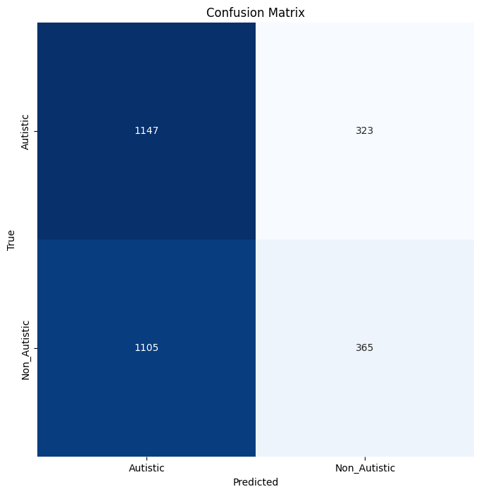
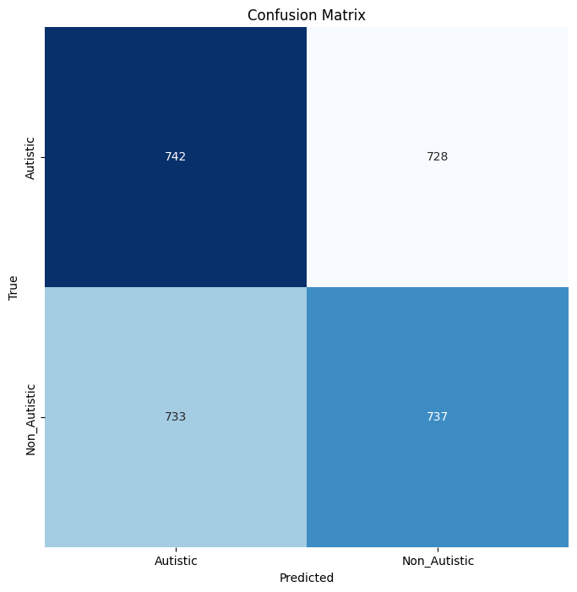
Result
ResNet 50
VGG16

Slide 21
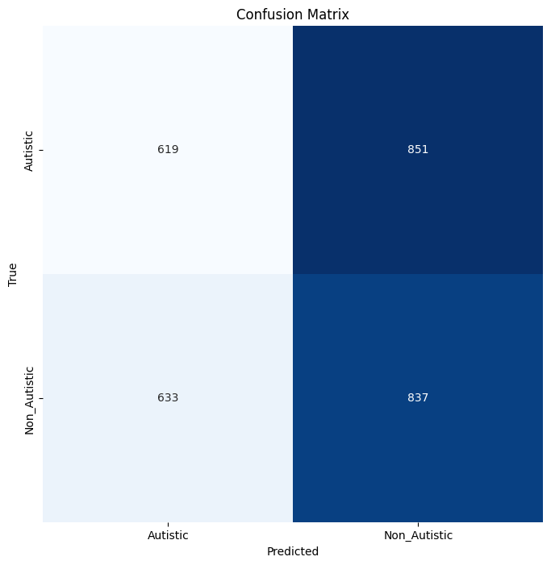
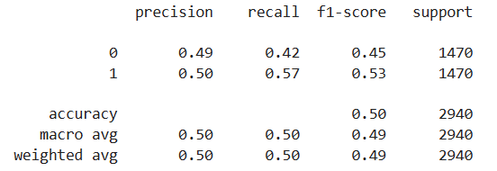
Result
Xception

Slide 22
Result
Model | Loss | Accuracy | Val Loss | Val Accuracy
Inception V3 | 0.1927 | 0.9282 | 0.3572 | 0.9
MobileNet V2 | 0.1 | 0.94 | 0.4 | 0.5
ResNet 50 | 0.16 | 0.93 | 0.77 | 0.7
Vgg 16 | 0.12 | 0.94 | 0.3 | 0.92
Xception | 0.09 | 0.95 | 0.29 | 0.9

Slide 23
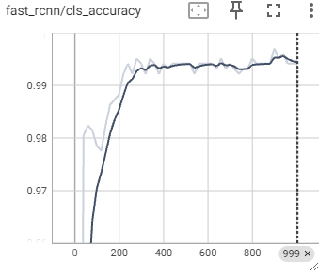
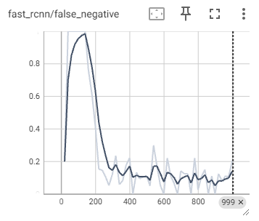
Result- Detectron2

Slide 24
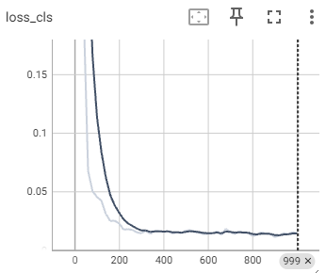
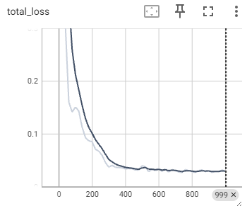
Result- Detectron2

Slide 25
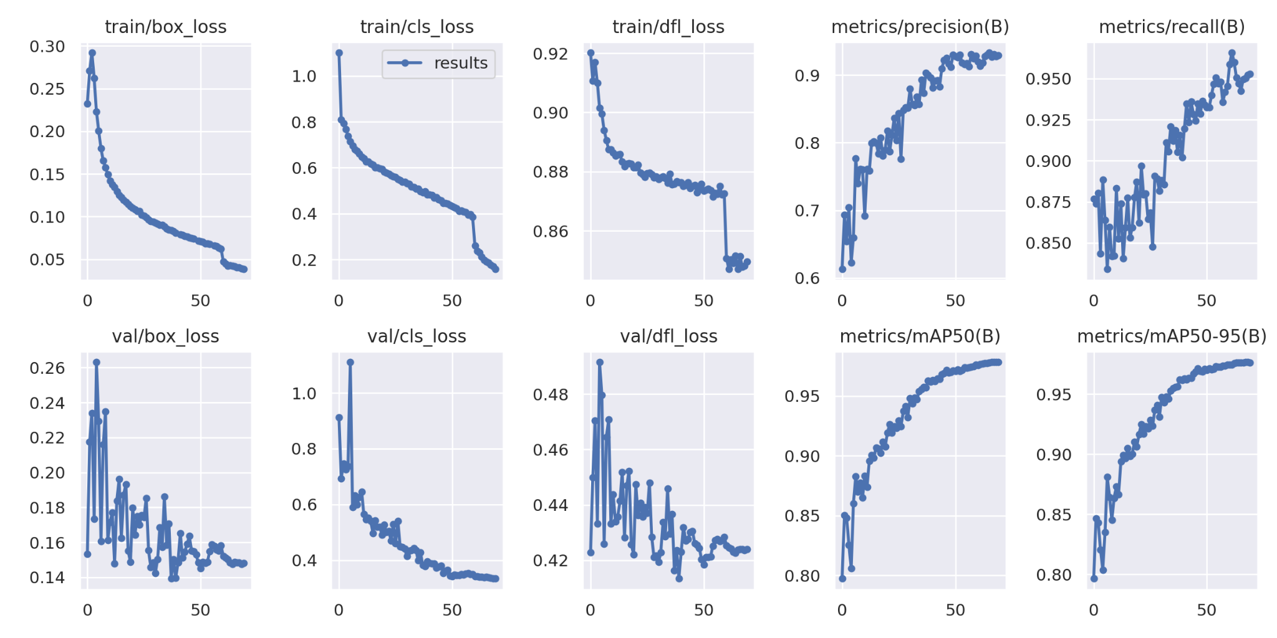
Result- YOLOv8

Slide 26
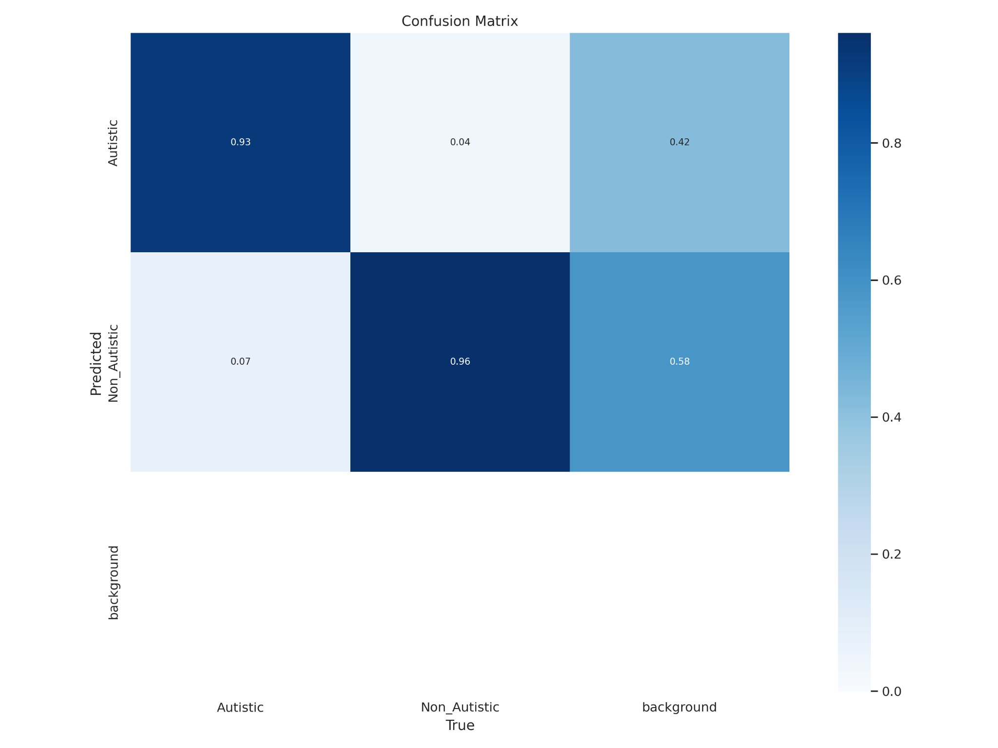
Result- YOLOv8

Slide 27
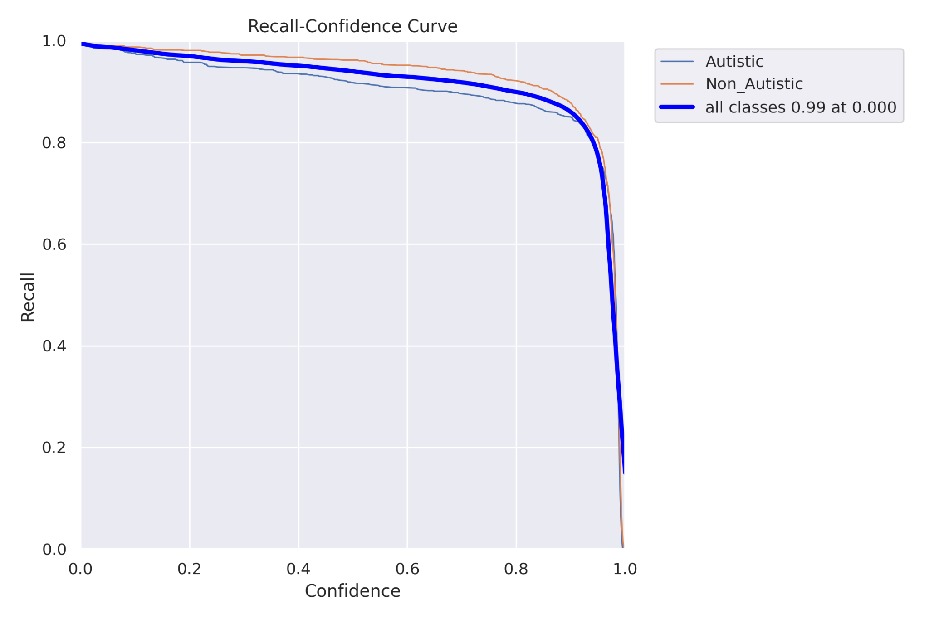
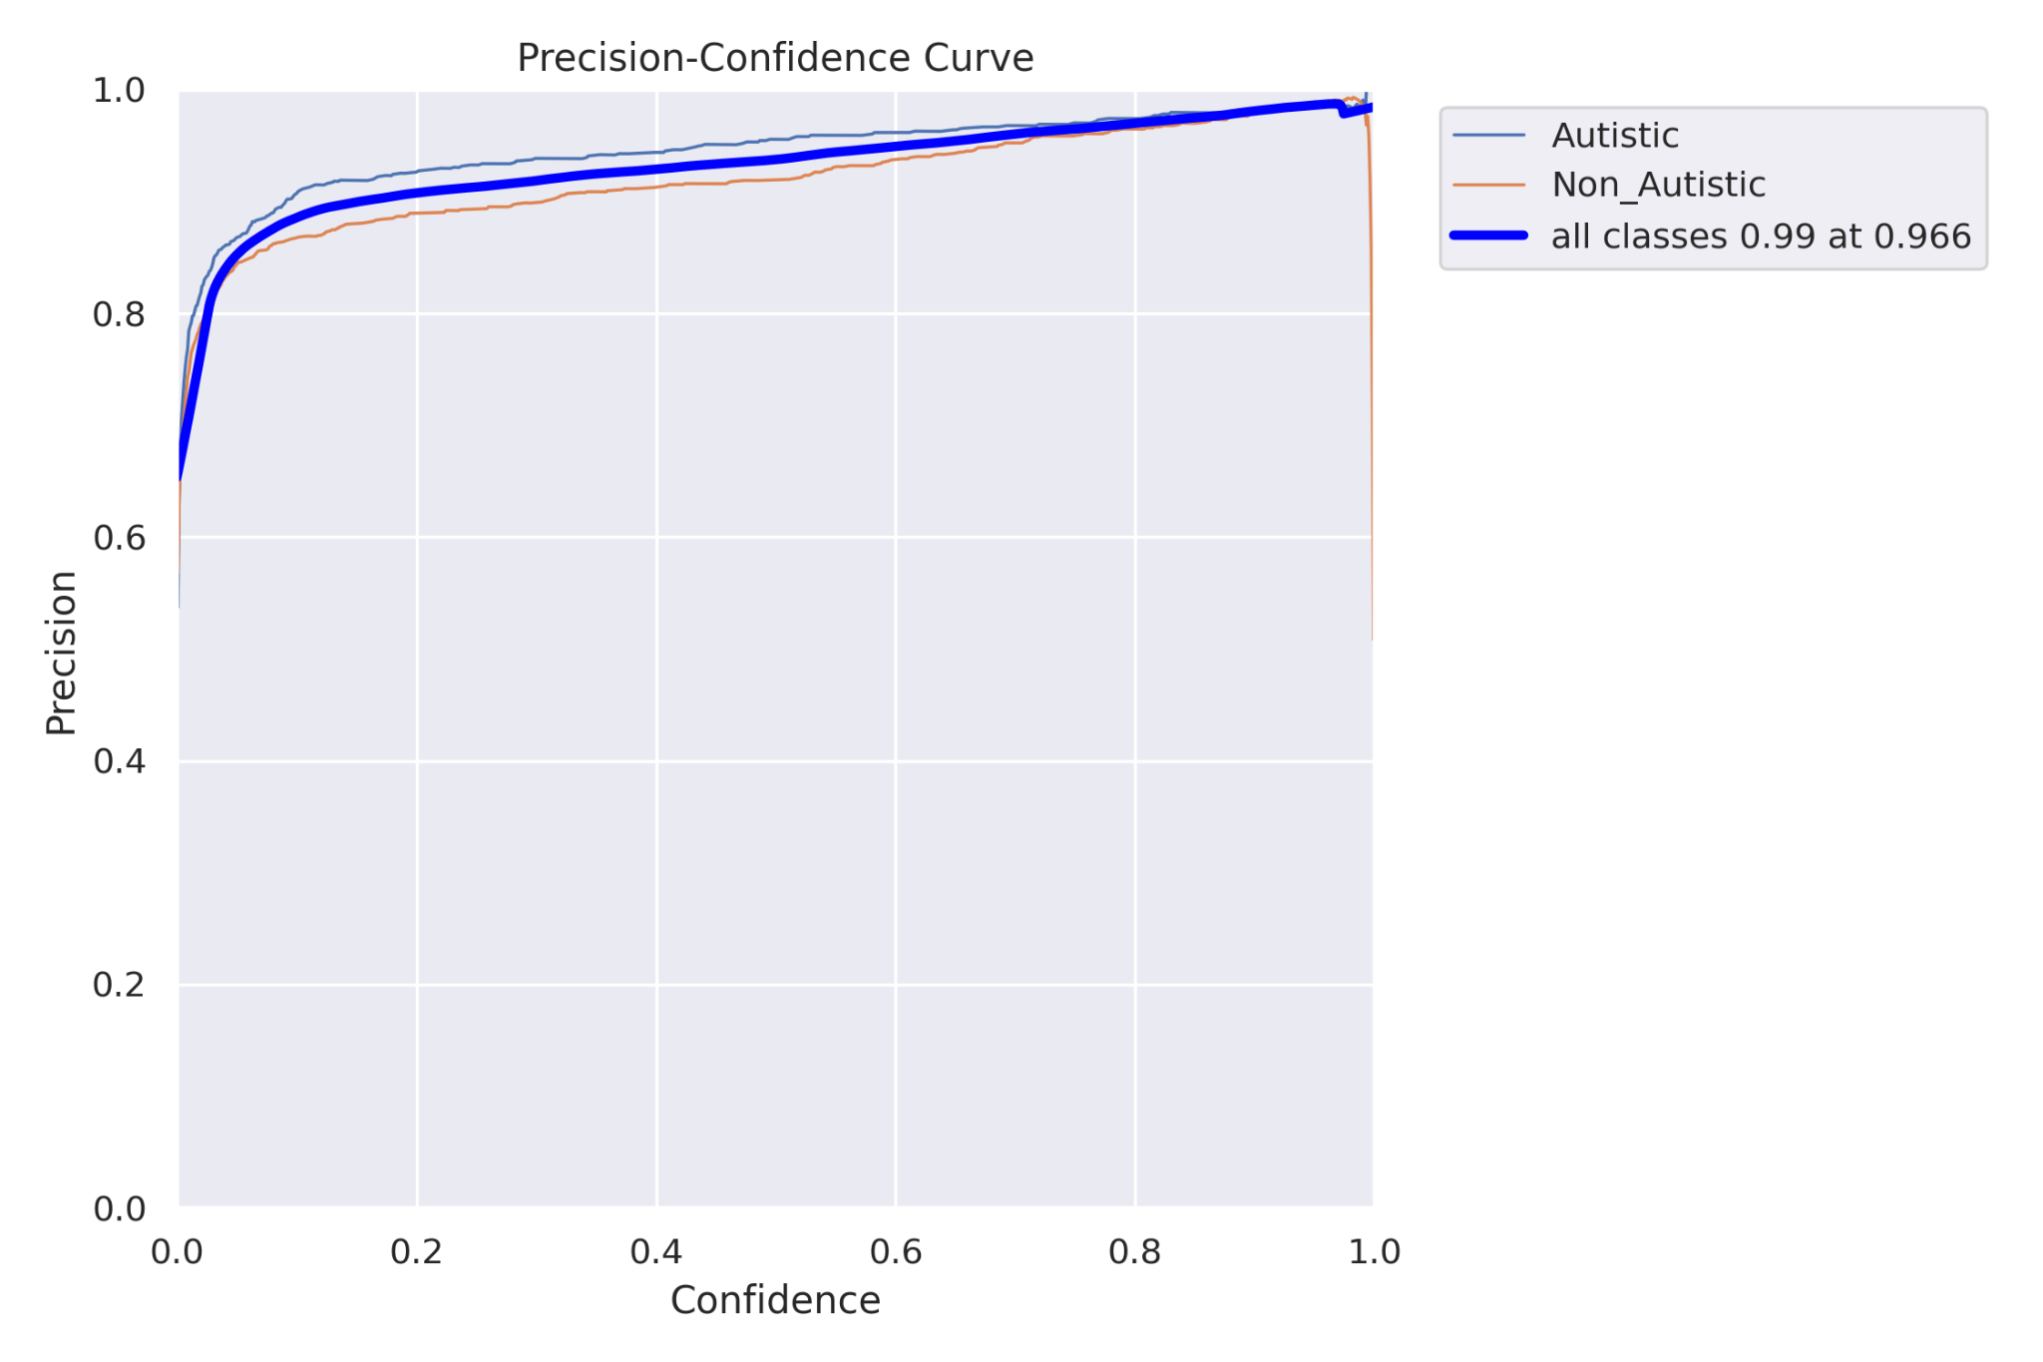
Result- YOLOv8

Slide 28
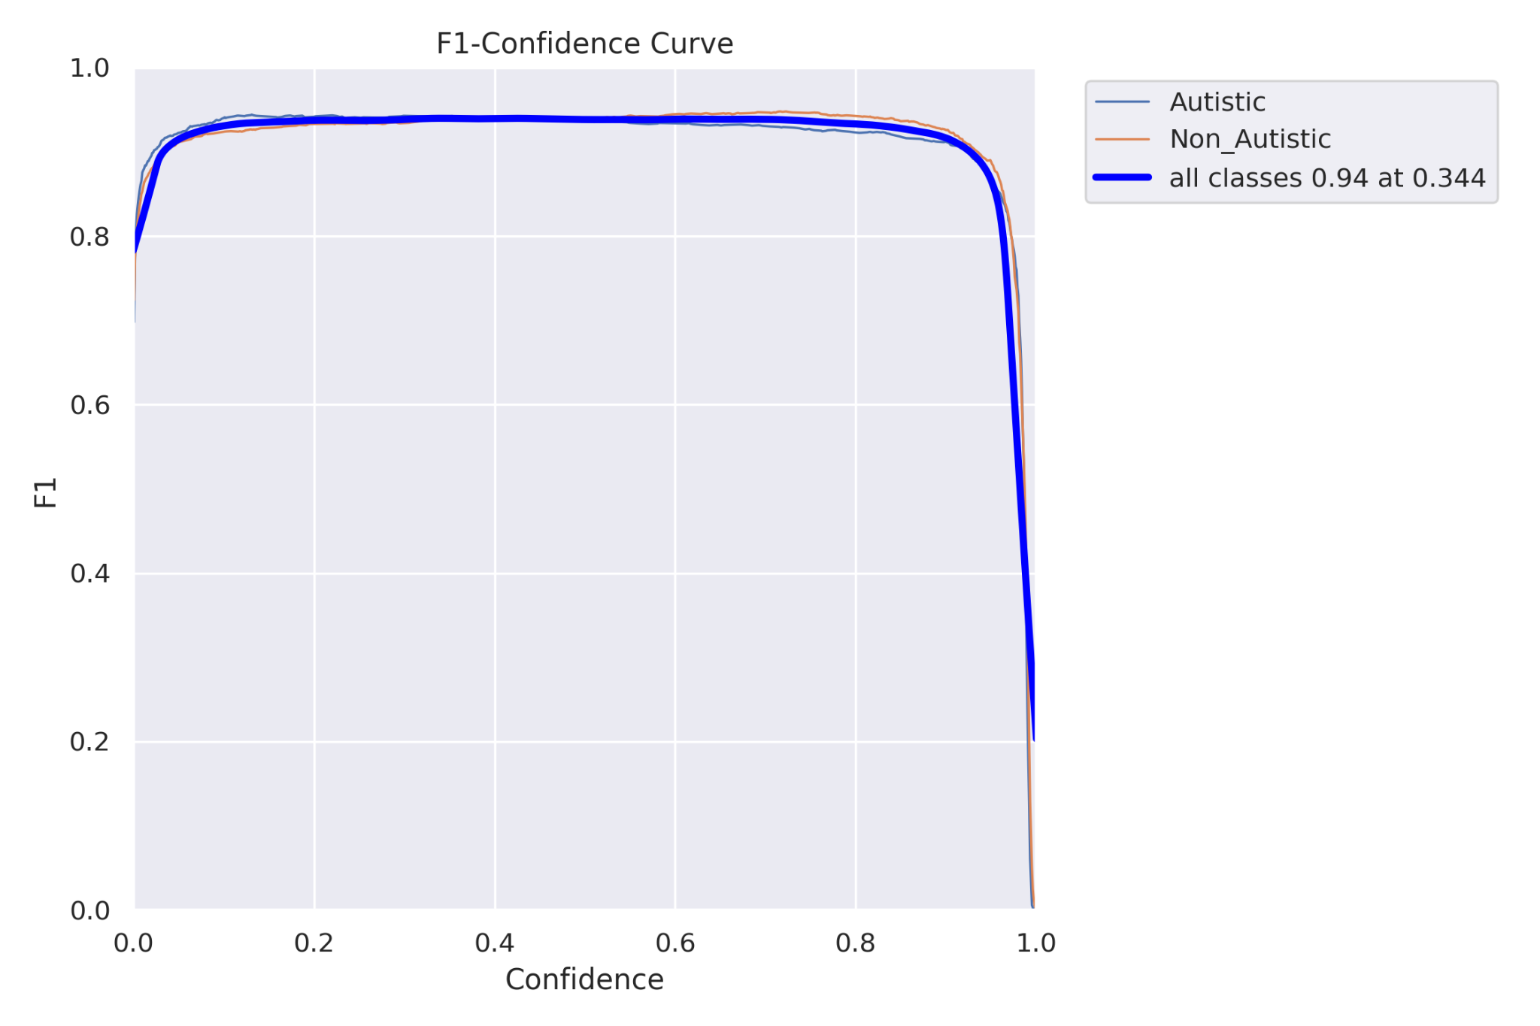
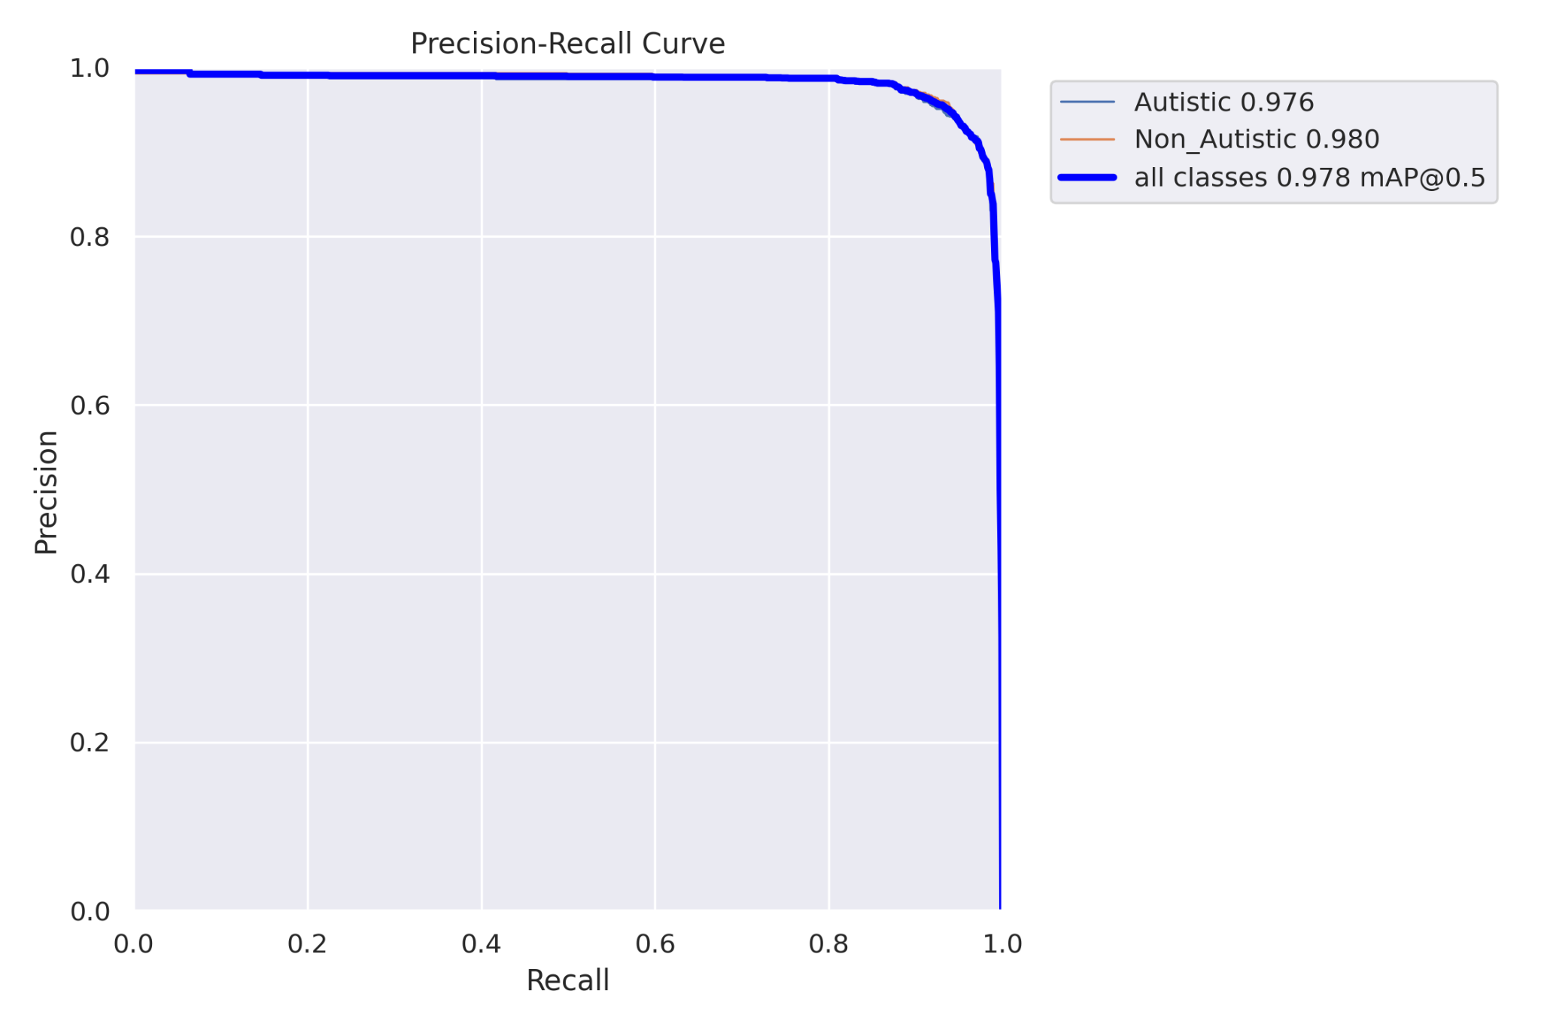
Result- YOLOv8

Slide 29
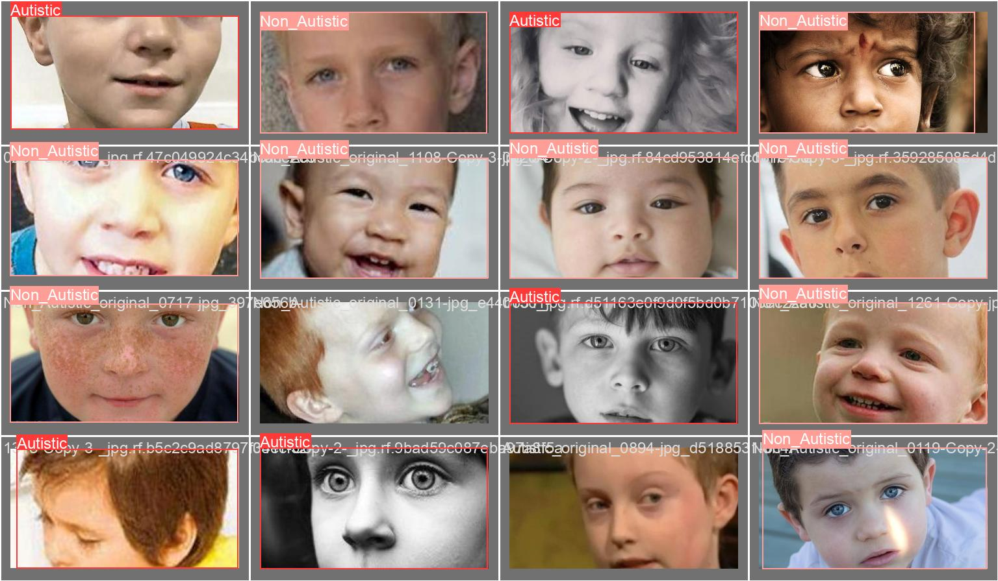

Result- YOLOv8
Validation results for batch-0:
Labels
Predicted

Slide 30
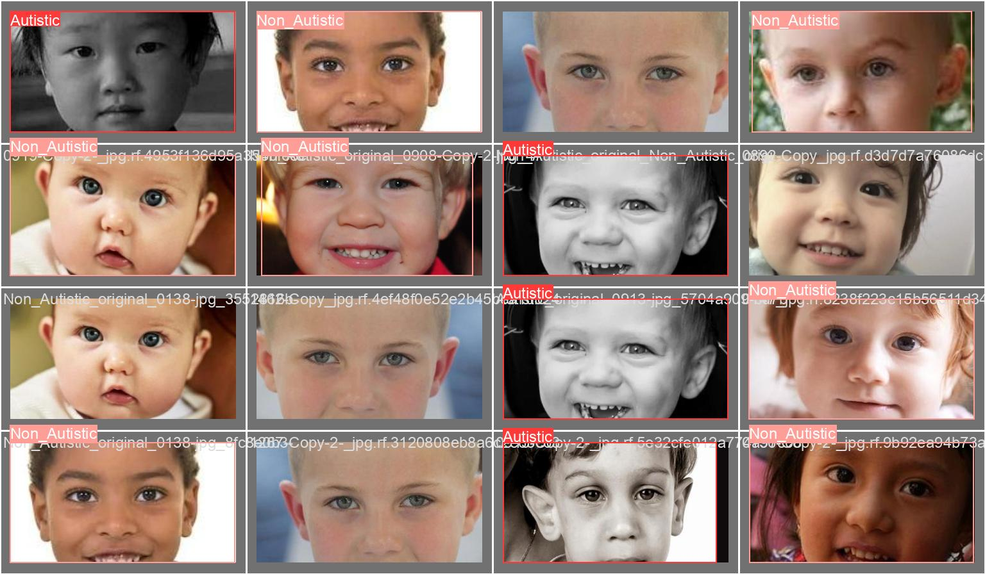
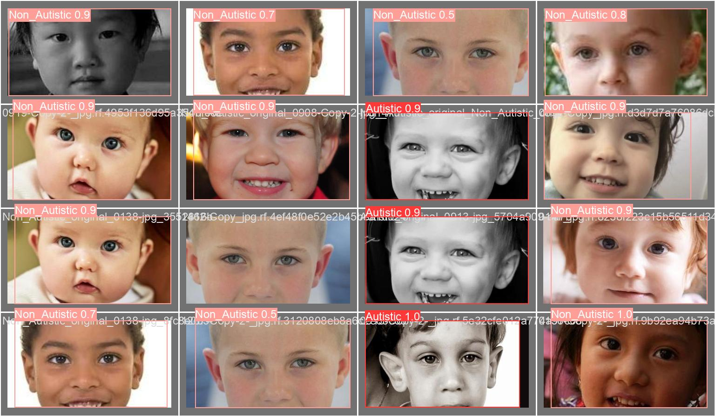
Result- YOLOv8
Validation results for batch-1:
Labels
Predicted

Slide 31
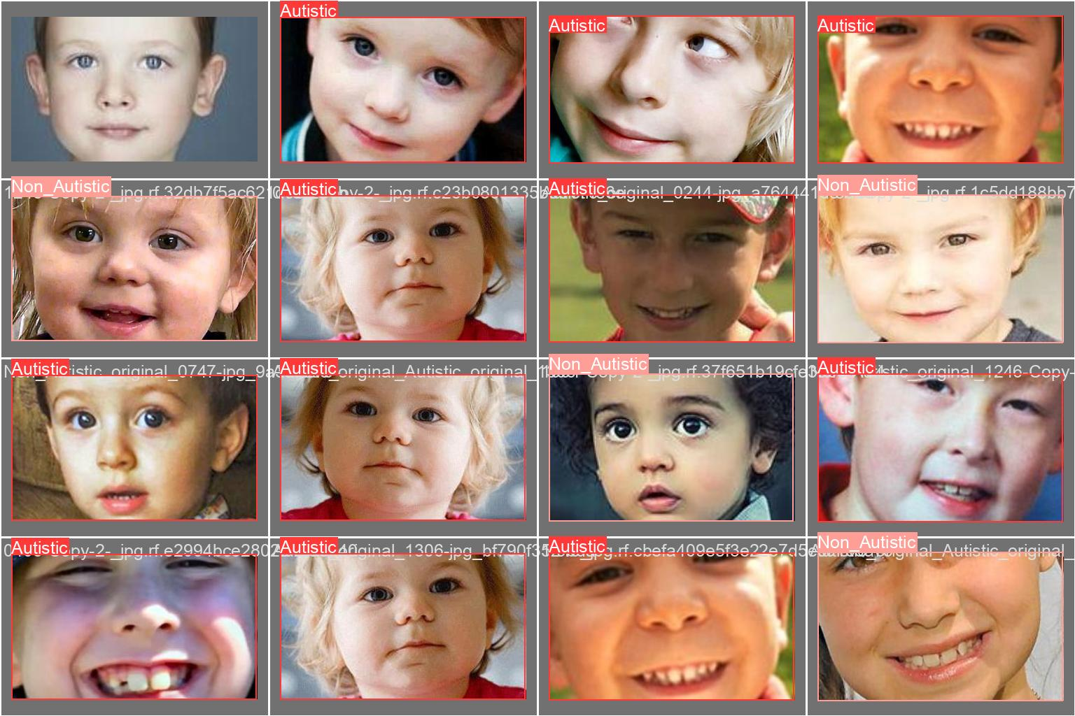
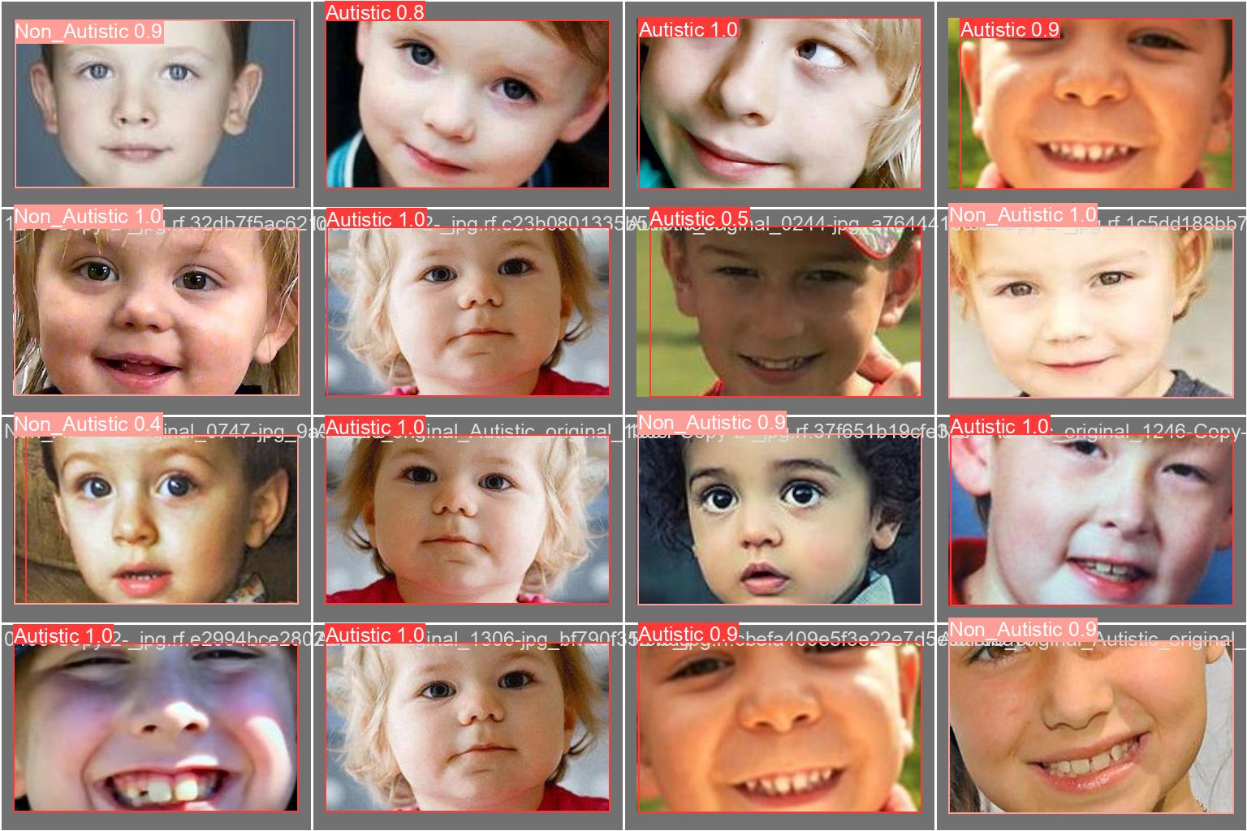
Result- YOLOv8
Validation results for batch-2:
Labels
Predicted

Slide 32
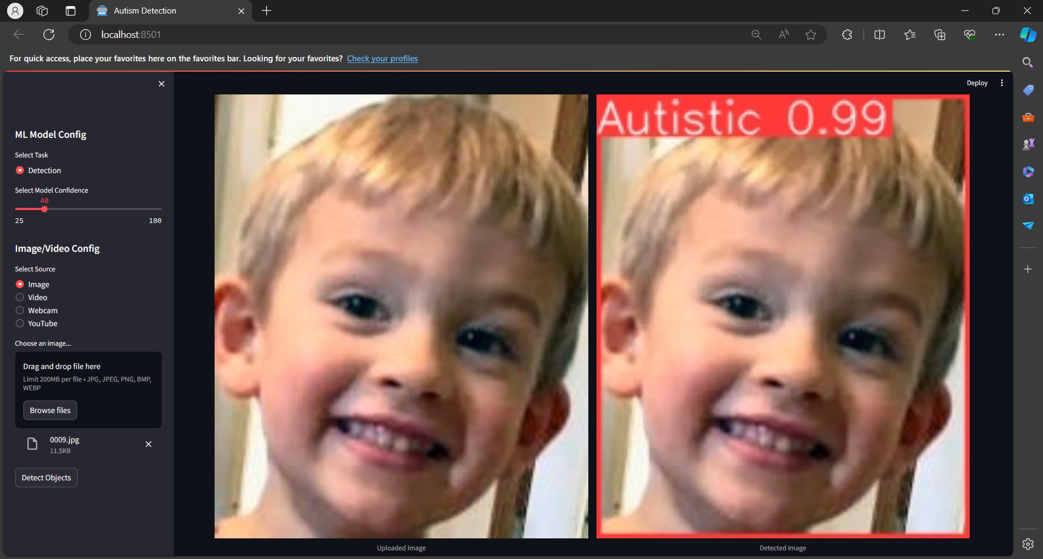
User Interface

Slide 33
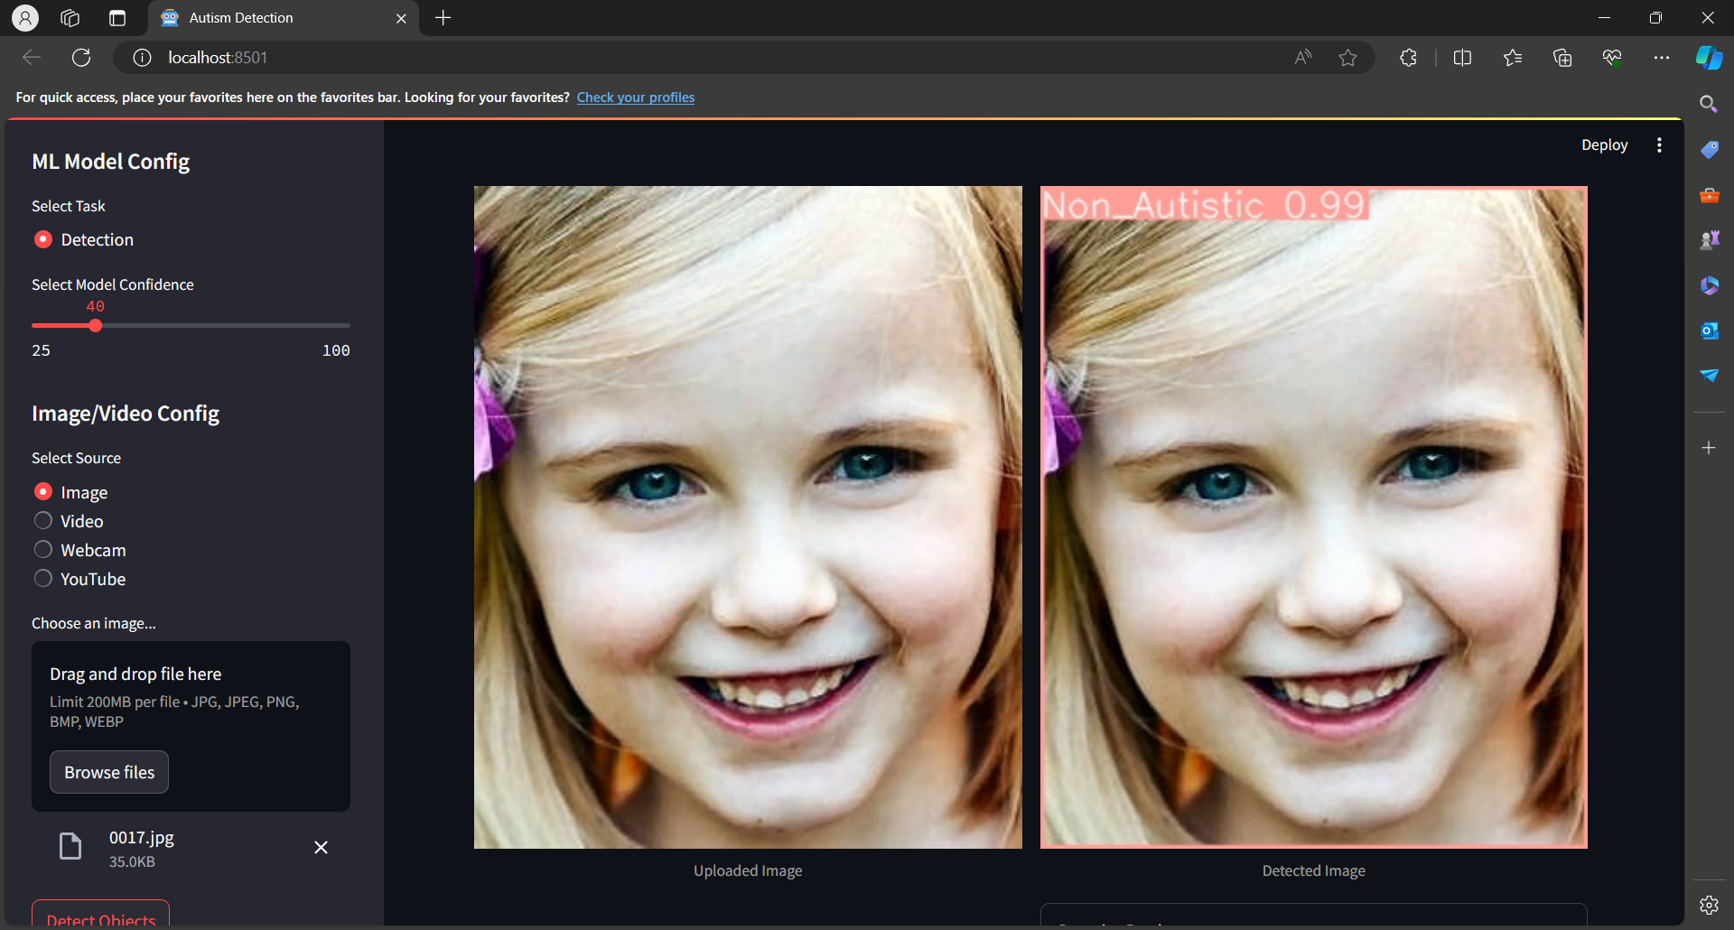
User Interface

Slide 34
Timeline
Abstract Submission
22-02-2024
Literature Survey
04-03-2024
Design [Front End, Back End]
20-03-2024
Implementation
03-04-2024
Testing
20-04-2024
Document Submission
05-05-2024

Slide 35
Conclusion
Employing advanced models like YOLOv8n or Detectron, the future of ASD diagnosis can be transformed into something more accurate and efficient. Such models bring out practical solutions in real time, considering that model strength lies in the extraction of features from any image without loss due to computation speed thereafter while requiring little power for processing them which may not allow enough room for deep learning parameters. An account of this is their effectiveness when using resources, their capability when it comes to detecting numerous objects and resistance to changes in the environment; because of these reasons robots are likely to operate in different hospitals and other medical institutions; in addition, they can be interconnected with medical information systems so that new automated systems are used for diagnosing ASD which facilitate the treatment and increases quality of patients life.

Slide 36
Future Scope
Further exploration could focus on enhancing the efficiency and scalability of the trained model by optimizing hyperparameters and exploring advanced training techniques. Additionally, investigating the model's performance on larger and more diverse datasets could provide valuable insights into its generalization capabilities across various real-world scenarios.

Slide 37
References
[1] Y. Du, H. Hao, Y. Xing, J. Niu and V. D. Calhoun, "A Transdiagnostic Biotype Detection Method for Schizophrenia and Autism Spectrum Disorder Based on Graph Kernel," 2021 43rd Annual International Conference of the IEEE Engineering in Medicine & Biology Society (EMBC), Mexico, 2021.
[2] S. Ram Arumugam, S. Ganesh Karuppasamy, S. Gowr, O. Manoj and K. Kalaivani, "A Deep Convolutional Neural Network based Detection System for Autism Spectrum Disorder in Facial images," 2021 Fifth International Conference on I-SMAC (IoT in Social, Mobile, Analytics and Cloud) (I-SMAC), Palladam, India, 2021.
[3]S. Bose and P. Seth, "Screening of Autism Spectrum Disorder using Machine Learning Approach in Accordance with DSM-5," 2023 7th International Conference on Electronics, Materials Engineering & Nano-Technology (IEMENTech), Kolkata, India, 2023.
[4]T. L. Praveena and N. V. M. Lakshmi, "Multi Label Classification for Emotion Analysis of Autism Spectrum Disorder Children using Deep Neural Networks," 2021 Third International Conference on Inventive Research in Computing Applications (ICIRCA), Coimbatore, India, 2021.

Slide 38
References
[5] M. S. Venkata Sai Krishna Narala, S. Vemuri and C. Kattula, "Prediction of Autism Spectrum Disorder Using Efficient Net," 2023 9th International Conference on Advanced Computing and Communication Systems (ICACCS), Coimbatore, India, 2023.
[6] V. P and U. M. V, "Identification of Autism Spectrum Disorder in Children from Facial Features Using Deep Learning," 2024 Fourth International Conference on Advances in Electrical, Computing, Communication and Sustainable Technologies (ICAECT), Bhilai, India, 2024.
[7]K. -F. Kollias, C. K. Syriopoulou-Delli, P. Sarigiannidis and G. F. Fragulis, "Autism detection in High-Functioning Adults with the application of Eye-Tracking technology and Machine Learning," 2022 11th International Conference on Modern Circuits and Systems Technologies (MOCAST), Bremen, Germany, 2022.

Slide 39
References
[8] S. R. Arumugam, R. Balakrishna, R. Khilar, O. Manoj and C. S. Shylaja, "Prediction of Autism Spectrum Disorder in Children using Face Recognition," 2021 2nd International Conference on Smart Electronics and Communication (ICOSEC), Trichy, India, 2021.
[9] R. Mittal, V. Malik and A. Rana, "DL-ASD: A Deep Learning Approach for Autism Spectrum Disorder," 2022 5th International Conference on Contemporary Computing and Informatics (IC3I), Uttar Pradesh, India, 2022.
[10\R. Chandra, S. Tiwari, A. Kumar, S. Agarwal, M. Syafrullah and K. Adiyarta, "Autism Spectrum Disorder Detection using Autistic Image Dataset," 2023 10th International Conference on Electrical Engineering, Computer Science and Informatics (EECSI), Palembang, Indonesia, 2023.

Slide 40
THANK YOU

